Slide 1
S25 7 Optimal High-T_{C} Superconductivity in Cs₃C₆₀
Dale R. Harshman The College of William and Mary Anthony T. Fiory New Jersey Institute of Technology

Slide 2
Superconducting T_{C} in A₃C₆₀ Systems
Draw Analogy to High-T_{C} Doping “Dome” Diagram: Doping Decreases with Volume per C₆₀
T_{C} of A15 and fcc Forms of Cs₃C₆₀ vary under Applied Pressure.
Maxima Determine Optimal Measured T_{C0}.
A15 T_{C0} = 38.36 K, P = 0.93 GPa
fcc T_{C0} = 35.2 K, P = 0.73 GPa
Optimal
Non-optimal Region Variable T_{C}, n_{S} (μSR), R_{H}
after A.Y. Ganin, et al., Nat. Lett. 466, 221 (2010), Fig. 4a

Slide 3
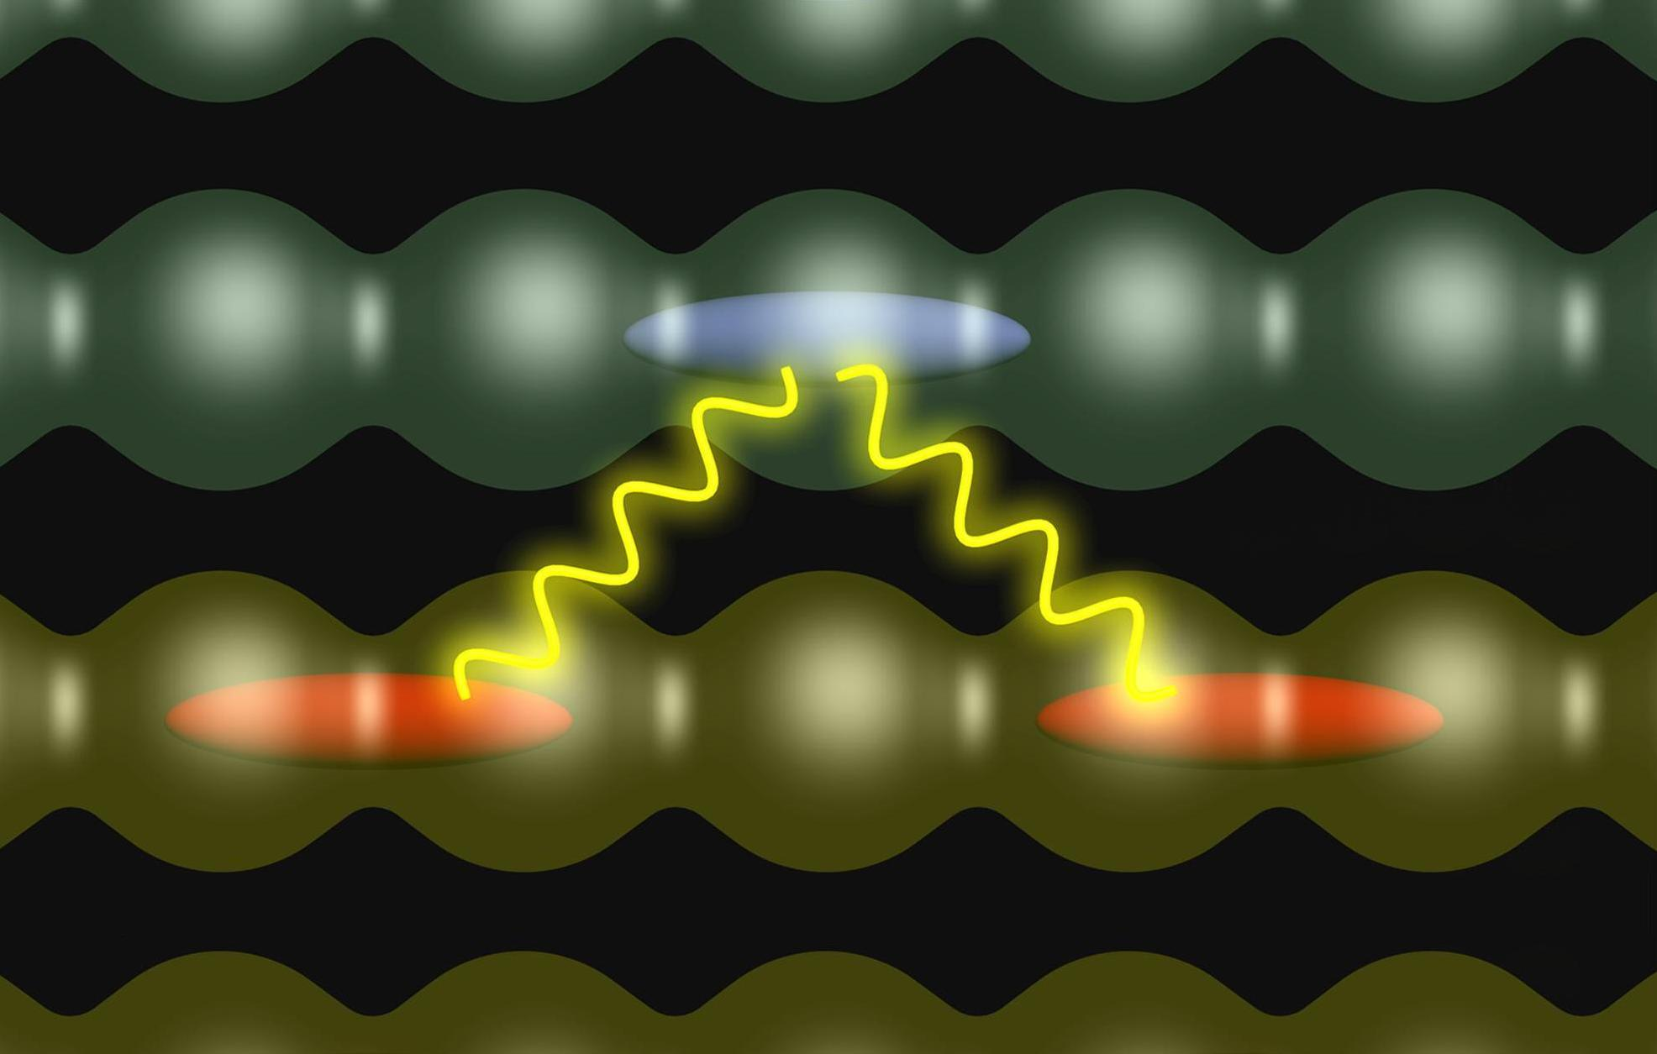
Coulombic-Based Layered High-T_{C} Model
Type II Reservoir (mediator) (η Layers)
ζ
Type I Reservoir (host)
(ν Layers)

Slide 4
High-T_{C} Optimal Transition Temperature
Coulomb interaction forces between adjacent charge reservoir layers determine optimal transition temperature
T_{C0} = k_{B}⁻¹e²Λ/ℓζ
ℓ⁻² = ησ/A
Interaction Charge Areal Density η Number of Type II layers (e.g., CuO₂) σ Interacting Charge Fraction Determined by doping and stoichiometry A Formula-unit Basal-plane Area
ζ Interaction Distance = Separation between adjacent layers
Λ Length scale Λ = 7.47 × 10⁻¹¹ cm (evaluated from experiment)

Slide 5
Theoretical High-T_{C} Model
Coulomb Interaction Energy Scale
e²/ζ
Interlayer Coulomb Interaction Potential
V_{int}(q) ~ exp(−qζ)
Coupling Strength
λ ∝ ⟨|qV_{int}(q)|²⟩ ∝ e⁴(ℓζ)^{–2}
From real-space approximation
With interaction charge density ℓ^{–2} = ση/A
Strong Coupling Form T_{C} ∝ λ^{1/2}
T_{C0} ∝ e²/ℓζ
D. R. Harshman, A. T. Fiory, J. Phys. Chem. Solids 85 (2015) 106-116

Slide 6
Determining Factional Charge σ
Charge Allocation Rules for Known Doping
σ = γ v [x − x₀]
1a) Sharing between N (typically 2) ions or structural layers/surfaces introduces a factor of 1/N in γ.
1b) Doping is shared equally between the two reservoirs, resulting in a factor of ½ in γ.
For optimal cuprate compounds of unknown doping, σ is calculated by scaling to σ₀ = 0.228 of YBa₂Cu₃O_{6.92}
Example
(Sr_{0.9}La_{0.1})CuO₂
x = 0.1 x₀ = 0

Slide 7
High-T_{C} Compounds Comprising One Layer in Each Charge Reservoir
Type I ν = 1 Type II η = 1
Sr_{0.9}La_{0.1}CuO₂ FeSe_{0.977} A_{x}S_{y}M⁽⁵⁾NCl
Example (Sr_{0.9}La_{0.1})CuO₂
γ = 1 (rule 1a) × ½ (rule 1b) = ½

Slide 8
Coulombic Based High-T_{C} Model − Results
T_{C0}^{calc.} = k_{B}^{–1}e²Λ(ℓζ)^{–1}
Λ = 0.00747 Å ≈ 2 /m₀c
Cs₃C₆₀ A15, fcc
This work

Slide 9
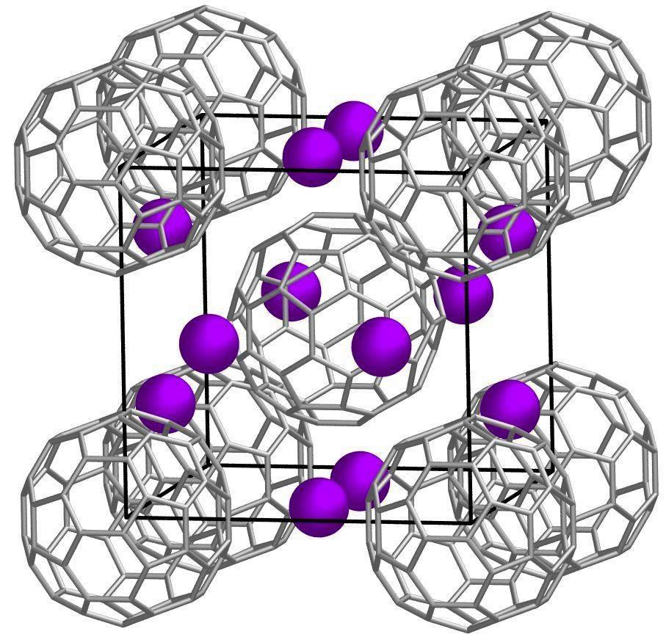
Extending High-T_{C} Layer Model to Cs₃C₆₀
Two Charge Reservoirs Model Type I ν = 1 Type II η = 1
Type I − 60 C on Bucky Ball Type II − 12 n-n Cs on Icosahedron
A15 Cs₃C₆₀ Structure bcc C₆₀ Ordered Packing Cs on 6d Tetrahedral Interstitial Sites
after Y. Takabayashi, et al., Science 323, 1585 (2009).
A = A_{C60} = 148.922 (Å²)

Slide 10
High-T_{C} Model A15 Cs₃C₆₀ Interaction Distance ζ
Cs at distance ζ from nearest C₆₀ hexagon center
ζ = 5^{½}a₀/4 – (R² – d ²)^{½} = 3.1952 Å
at P = 0.93 GPa & T ∼ T_{C}

Slide 11
High-T_{C} Model fcc Cs₃C₆₀
fcc packing C₆₀ − merohedral disorder
Cs on Tetrahedral Interstitial Sites 8 at distance ζ_{(T)} from C₆₀ hexagon center
Cs on Octahedral Interstitial Sites 6 at distance ζ_{(O)} from midpoint of C-6:6 bond
ζ_{(T)} = 3^{½}a₀/4 – [R² – d ²] ^{½} = 3.0203 Å
ζ_{(O)} = a₀/2 – [R² – (d_{6:6}/2)²]^{½} = 3.7616 Å
at P = 0.73 GPa, T ∼ T_{C}
ζ = (8/14) ζ_{(T)} + (6/14) ζ_{(O)} = 3.3380 Å

Slide 12
Calculating T_{C0} for Cs₃C₆₀
Fractional Charge
σ= γ v [x]
Cs_{x}⁺¹ : doping x ≈ 3, valence v = 1
From Rule 1a)
ν = 1 η = 1 → factor unity in γ
From Rule 1b)
Two reservoirs → factor ½ in γ
σ = (1/2) [x]
T_{C0}^{calc.} = (72.28 K-Å) [x]^{1/2} ζ^{–1}

Slide 13
Results for Cs₃C₆₀
T_{C0}^{calc.} = (72.28 K-Å) [x]^{1/2} ζ^{–1}
Dichotomy in transition temperature largely reflects differences in ζ

Slide 14
Conclusions
A15 Cs_{2.85(1)}C₆₀
T_{C0}^{calc.} = 38.19 K agrees well with T_{C0}^{meas.} = 38.36 K
fcc Cs_{2.901(6)}C₆₀
T_{C0}^{calc.} = 36.88 K is 5% higher than T_{C0}^{meas.} = 35.2 K
Possible reason for less impressive fcc agreement:
C₆₀ orientations: Merohedral disorder
Cs occupancies: Two sites, T and O
Pair breaking T_{C} < T_{C0} tied to disorder

Slide 15
Acknowledgements
W. J. Kossler
The College of William and Mary
N. M. Ravindra
New Jersey Institute of Technology
Emails
drh@physikon.net
fiory@alum.mit.edu

